Slide 1
Maximum Margin Classifier / Kernel Machine / Support Vector Machine
Tae-Kyun Kim
Senior Lecturer
https://labicvl.github.io/

Slide 2
Some references on Kernel
ICML 2018
Optimal Tuning for Divide-and-conquer Kernel Ridge Regression with Massive Data, Ganggang Xu · Zuofeng Shang · Guang Cheng
BOCK : Bayesian Optimization with Cylindrical Kernels, ChangYong Oh · Efstratios Gavves · Max Welling
Differentiable Compositional Kernel Learning for Gaussian Processes, Shengyang Sun · Guodong Zhang · Chaoqi Wang · Wenyuan Zeng · Jiaman Li · Roger Grosse
The Weighted Kendall and High-order Kernels for Permutations, Yunlong Jiao · Jean-Philippe Vert
Kernelized Synaptic Weight Matrices, Lorenz Müller · Julien Martel · Giacomo Indiveri
AutoPrognosis: Automated Clinical Prognostic Modeling via Bayesian Optimization with Structured Kernel Learning, Ahmed M. Alaa Ibrahim · M van der Schaar
To Understand Deep Learning We Need to Understand Kernel Learning, Mikhail Belkin · Siyuan Ma · Soumik Mandal
Kernel Recursive ABC: Point Estimation with Intractable Likelihood, Takafumi Kajihara · Motonobu Kanagawa · Keisuke Yamazaki · Kenji Fukumizu
Differentially Private Database Release via Kernel Mean Embeddings, Matej Balog · Ilya Tolstikhin · Bernhard Schölkopf
Learning in Reproducing Kernel Kreı̆n Spaces, Dino Oglic · Thomas Gaertner
Trainable Calibration Measures for Neural Networks from Kernel Mean Embeddings, Aviral Kumar · Sunita Sarawagi · Ujjwal Jain
Adaptive Sampled Softmax with Kernel Based Sampling, Guy Blanc · Steffen Rendle
NIPS 2018
Persistence Fisher Kernel: A Riemannian Manifold Kernel for Persistence Diagrams, Tam Le · Makoto Yamada
Neural Tangent Kernel: Convergence and Generalization in Neural Networks, Arthur Jacot-Guillarmod · Clement Hongler · Franck Gabriel
Statistical and Computational Trade-Offs in Kernel K-Means, Daniele Calandriello · Lorenzo Rosasco
RetGK: Graph Kernels based on Return Probabilities of Random Walks, Zhen Zhang · Mianzhi Wang · Yijian Xiang · Yan Huang · Arye Nehorai
Learning Bounds for Greedy Approximation with Explicit Feature Maps from Multiple Kernels, Shahin Shahrampour · Vahid Tarokh
Quadrature-based features for kernel approximation, Marina Munkhoeva · Yermek Kapushev · Evgeny Burnaev · Ivan Oseledets
Causal Inference via Kernel Deviance Measures, Jovana Mitrovic · Dino Sejdinovic · Yee Whye Teh
KONG: Kernels for ordered-neighborhood graphs, Moez Draief · Konstantin Kutzkov · Kevin Scaman · Milan Vojnovic
Continuous-time Value Function Approximation in Reproducing Kernel Hilbert Spaces, Motoya Ohnishi · Masahiro Yukawa · Mikael Johansson · Masashi Sugiyama
Semi-supervised Deep Kernel Learning: Regression with Unlabeled Data by Minimizing Predictive Variance, Neal Jean · Sang Michael Xie · Stefano Ermon
Streaming Kernel PCA with ~O(√n) Random Features, Md Enayat Ullah · Poorya Mianjy · Teodor Vanislavov Marinov · Raman Arora

Slide 3
Discriminative linear classifier
……
query input x ∈ R^{D}
Training samples x_{n} ∈ R^{D}
, n=1,,,N
+1
……
……
……
……
Class 1
-1
……
……
……
……
decision hyperplane:
sign(y(x) = w^{T}x + b)
Class 2

Slide 4
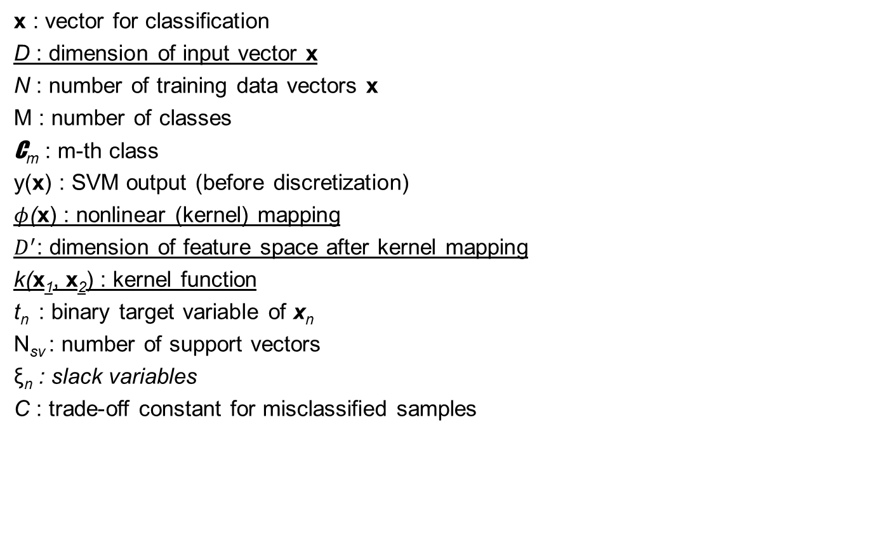
Notations
x : vector for classification
D : dimension of input vector x
N : number of training data vectors x
M : number of classes
C_{m} : m-th class
y(x) : SVM output (before discretization)
$φ$(x) : nonlinear (kernel) mapping
$D^{′}$: dimension of feature space after kernel mapping
k(x₁, x₂) : kernel function
t_{n} : binary target variable of x_{n}
N_{sv} : number of support vectors
ξ_{n} : slack variables
C : trade-off constant for misclassified samples

Slide 5
Linear discriminant function
A discriminant function maps an input vector x into one of M classes, denoted C_{m}.
For simplicity, consider two classes.
Linear discriminant function takes the form of
y(x) = w^{T}x + b
where w is a weight vector and b a bias.
A vector x is assigned to C₁ if y(x) ≥ 0, and C₂ otherwise.
x₂
y > 0
y = 0
C₁
y < 0
C₂
w, b
x₁

Slide 6
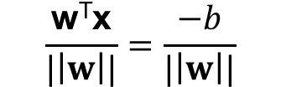

Linear discriminant function
The decision boundary is defined by y(x) = 0, which is a (K-1)-dimensional hyperplane in the K-dimensional input space.
Consider x_{A} and x_{B} on the decision surface:
y(x_{A}) = y(x_{B}) = 0
w^{T}(x_{A}-x_{B}) = 0
x₂
y > 0
The vector w is orthogonal to the decision surface. w determines the direction of the decision surface.
For x on the decision surface, y(x) = 0, so the normal distance from the origin to the decision surface is
Thus, b determines the location of the decision surface.
y = 0
C₁
y < 0
C₂
w
x
x₁
$$\frac{\text{w}\text{T}\text{x}}{|\left|w\right||}=\frac{−b}{|\left|w\right||}$$
$\frac{\text{w}\text{T}\text{x}}{|\left|w\right||}$=$\frac{−b}{|\left|w\right||}$

Slide 7
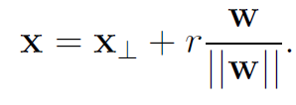
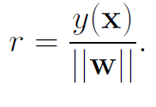


Linear discriminant function
For an arbitrary point x, its orthogonal projection onto the decision surface x⊥ is such that
Multiply both sides by w^{T} and add b, and use y(x) = w^{T}x + b and y(x⊥) = w^{T}x⊥+ b = 0, we have
x₂
y > 0
y = 0
C₁
y < 0
C₂
x
w
$$\frac{y(x)}{|\left|w\right||}$$
x⊥
x₁
$$\frac{−b}{|\left|w\right||}$$

Slide 8
Kernel trick
Linear discriminant functions separate data linearly:
Dataset is often not linearly separable:
We can map it to a higher-dimensional space, then separate it linearly:

Slide 9


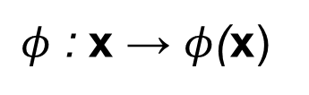
Kernel trick
The input space is transformed into a higher-dimensional feature space by a nonlinear mapping $φ$ : x → $φ$(x), where a linear decision boundary can separate all data points.
This second feature space may have a high or even infinite dimension.
$φ$ : x → $φ$(x)
a nonlinear mapping
R^{D}
R^{D’}
where
$${ D}^{′}>D$$

Slide 10
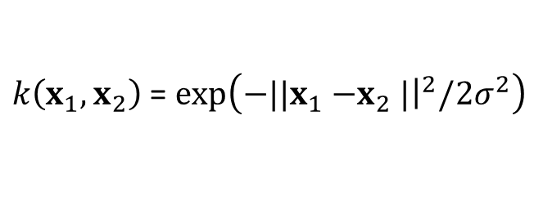
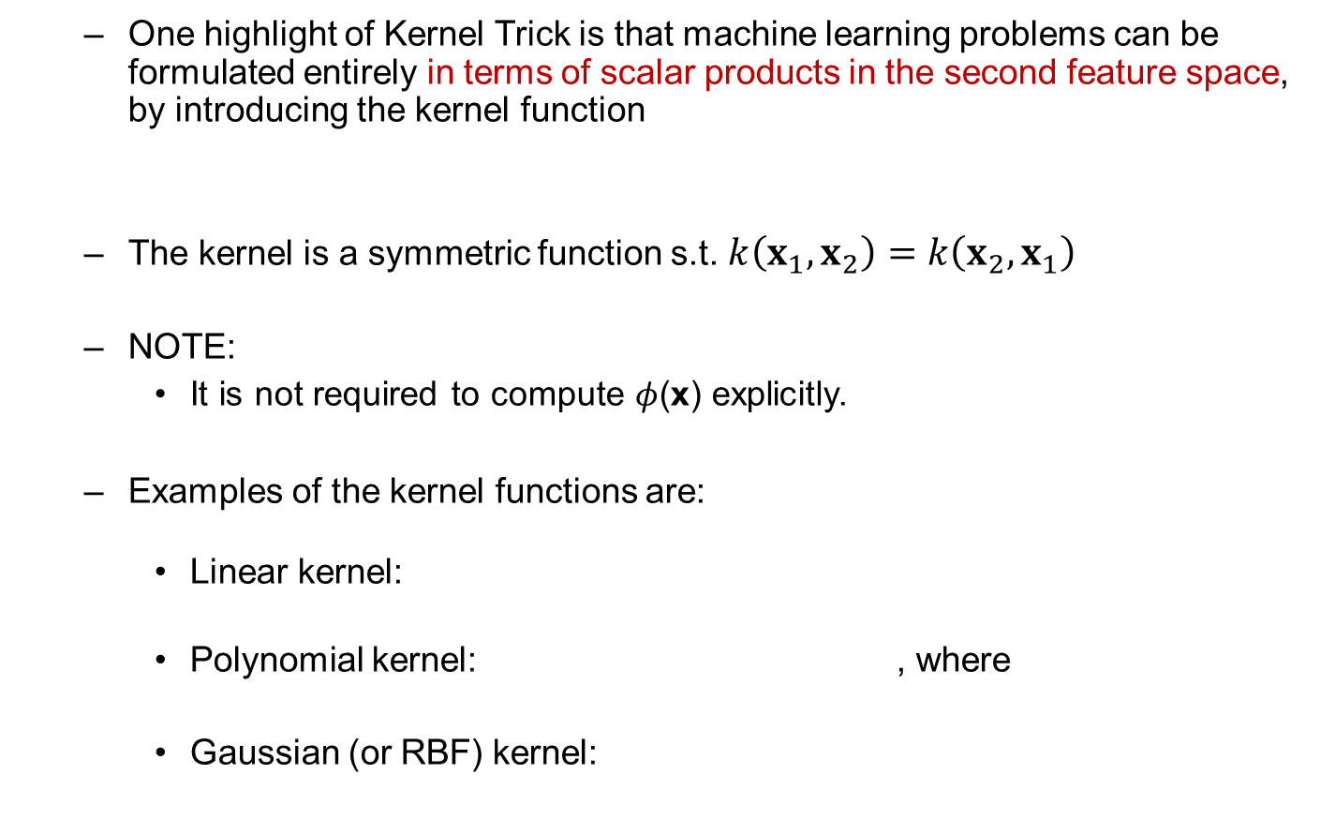




Kernel trick
One highlight of Kernel Trick is that machine learning problems can be formulated entirely in terms of scalar products in the second feature space, by introducing the kernel function
The kernel is a symmetric function s.t. $k\left(x_{1},x_{2}\right)=$ $k\left(x_{2},x_{1}\right)$
NOTE:
It is not required to compute $φ$(x) explicitly.
Examples of the kernel functions are:
Linear kernel:
Polynomial kernel: , where
Gaussian (or RBF) kernel:
$$k\left(x_{1},x_{2}\right)=φ\text{(}x_{1}\text{)}\text{T}φ\text{(}x_{2}\text{)}$$
$k\left(x_{1},x_{2}\right)$ = $x_{1}^{T}x_{2}$
$k\left(x_{1},x_{2}\right)$ = ${\left(x_{1}^{T}x_{2}+c\right)}^{M}$
$$c>0$$
$k\left(x_{1},x_{2}\right)$ = $exp\left({−||x}_{1}{−x}_{2}|{\left.​\right|}^{2}/2σ^{2}\right)$

Slide 11
Maximum margin classifier / Sparse kernel machine / Support vector machine
The classifier finds a hyperplane which separates two-class data with maximal margin.
The margin is defined as the distance of the closest training point to the separating or decision hyperplane.
Thus it is also called maximum margin classifier.
It can be shown that the support vectors are those feature vectors lying nearest to the decision hyperplane.
It has sparse solutions i.e. the predictions for new inputs depend only on the kernel function evaluated at a subset of the training data points, which are called support vectors.
Thus it is also called sparse kernel machine.

Slide 12

Maximum margin classifier
We have N training data vectors x₁, …, x_{N} and their target values t₁, … , t_{N} where t_{n} ∈ {-1, 1}.
For the two-class problem it takes the form of
where ϕ(x) denotes the feature mapping, w is the weight vector and b the bias.
Data points x are classified by the sign of y(x).
Assume that the training data is linearly separable in the feature space. Thus, optimal w and b satisfy
t_{n}y(x_{n}) > 0
for all training data points.

Slide 13




Maximum margin classifier
The perpendicular distance of a point x from a hyperplane y(x) is
|y(x)|/||w||
As we assume t_{n}y(x_{n}) > 0 for all n, the distance of a point x_{n} to the decision surface is
y > 0
y = 0
y < 0
$φ$(x)
w
$$\frac{y(x)}{|\left|w\right||}$$
$$φ(\text{x}\text{⊥})$$
$$\frac{−b}{|\left|w\right||}$$

Slide 14
Maximum margin classifier
The margin is the minimum perpendicular distance:
We find w and b that maximise the margin i.e.
y > 0
y = 0
y < 0
margin
decision hyperplane
margin hyperplanes

Slide 15
Canonical representation of decision hyperplane
Rescaling w → sw and b → sb does not change the distance from any point x_{n} to the decision hyperplane.
We can therefore set
for the point that is closest to the hyperplane.
All data points satisfy
y =1
y = 0
y =-1
margin
decision hyperplane
margin hyperplanes

Slide 16
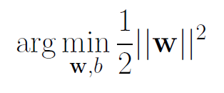
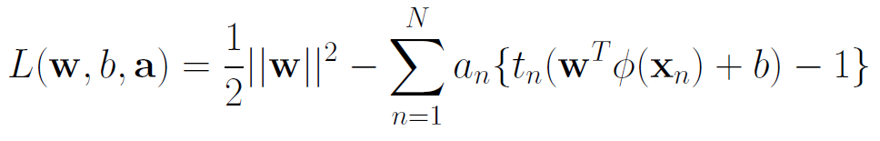
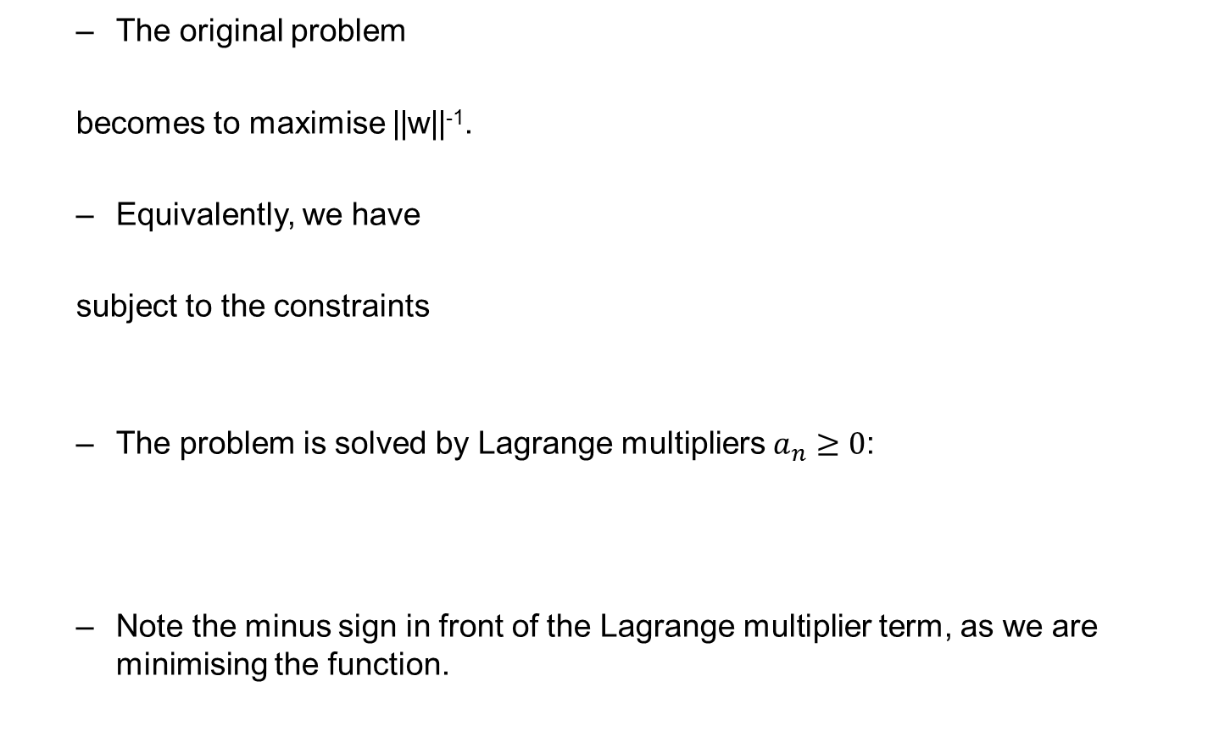
Optimisation
The original problem
becomes to maximise ||w||⁻¹.
Equivalently, we have
subject to the constraints
The problem is solved by Lagrange multipliers $a_{n}≥0$:
Note the minus sign in front of the Lagrange multiplier term, as we are minimising the function.

Slide 17


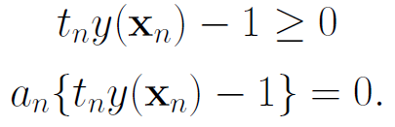
Optimisation
Karush-Kuhn-Tucker (KKT) conditions of the generic Lagrange function with inequality constraints are
The KKT conditions for SVM are
For every data point, a_{n}=0 or t_{n}y(x_{n}) =1.
Any data point for which a_{n}=0 plays no role in making predictions.
The remaining data points are called support vectors, and they satisfy t_{n}y(x_{n}) =1, i.e. lying on the margin hyperplanes.
KKT conditions

Slide 18
Optimisation
decision hyperplane
y =1
y = 0
y =-1
margin hyperplanes
margin
Support vectors (in circle) lie on the margin hyperplanes.

Slide 19
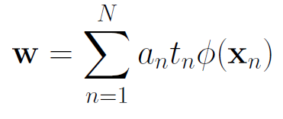

Optimisation
Setting the derivative of L(w, b, a) w.r.t. w to zero, we obtain
The decision function
takes the form of
where $a_{n}≥0$, x_{n} are the training data, t_{n} are the label, b is the bias, and
Further reading:
Christopher J.C. Burges, A Tutorial on Support Vector Machines for Pattern Recognition (http://research.microsoft.com/pubs/67119/svmtutorial.pdf)

Slide 20
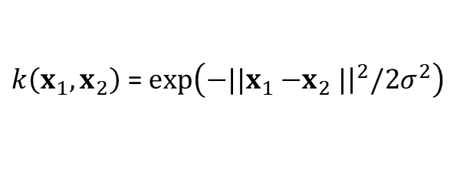
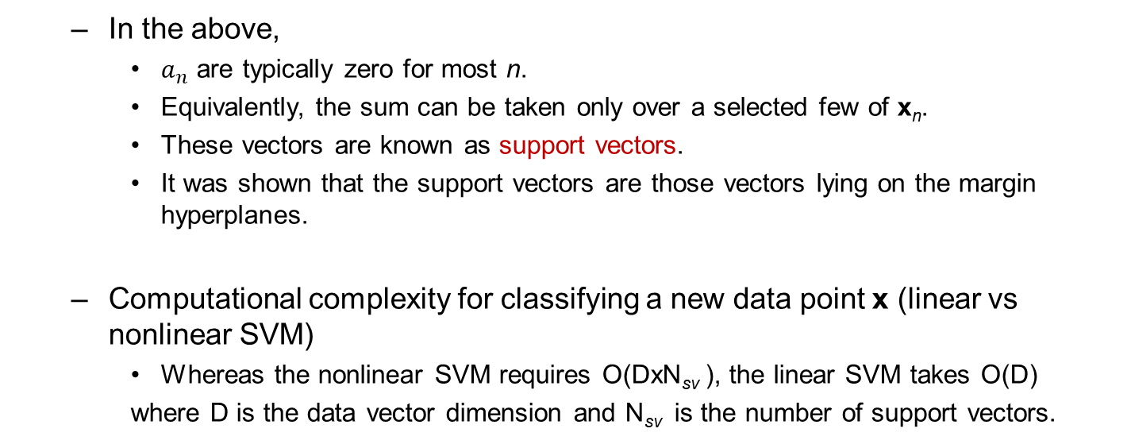
Optimisation
In the above,
$a_{n}$ are typically zero for most n.
Equivalently, the sum can be taken only over a selected few of x_{n}.
These vectors are known as support vectors.
It was shown that the support vectors are those vectors lying on the margin hyperplanes.
Computational complexity for classifying a new data point x (linear vs nonlinear SVM)
Whereas the nonlinear SVM requires O(DxN_{sv} ), the linear SVM takes O(D)
where D is the data vector dimension and N_{sv} is the number of support vectors.
Nonlinear:
where
$k\left(x_{1},x_{2}\right)$ = $exp\left({−||x}_{1}{−x}_{2}|{\left.​\right|}^{2}/2σ^{2}\right)$
Linear:
pre-computed

Slide 21
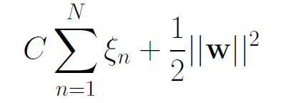

Overlapping class distributions (soft margin)
It penalizes samples by ξ_{n} ≥ 0, n=1,...,N s.t.
ξ_{n} = 0 for data points that are on or inside the correct margin boundary
ξ_{n} =|t_{n} - y(x_{n})| for other points.
We therefore minimise
where C > 0 is a trade-off constant and ξ_{n} ≥ 0, subject to
y =1
y = 0
y =-1
ξ= 0
ξ>1
ξ<1
margin
Support vectors are shown in circle

Slide 22
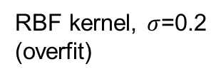
Overfitting
The kernel k (type and parameter) and other hyper-parameters (C) are problem dependent and need to be determined by a user.
Simple model has better generalization to unseen data, complex model can be overfitted to training data.
However, simple model may exhibit a limited separation (underfitting).
Linear kernel (underfit in this example)
RBF kernel, $σ$=0.2
(overfit)

Slide 23

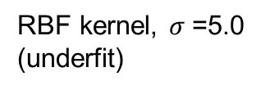
Overfitting
RBF kernel, $σ$=1.0
RBF kernel, $σ$=5.0
(underfit)

Slide 24
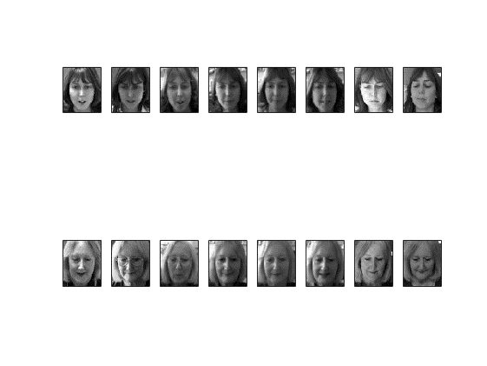
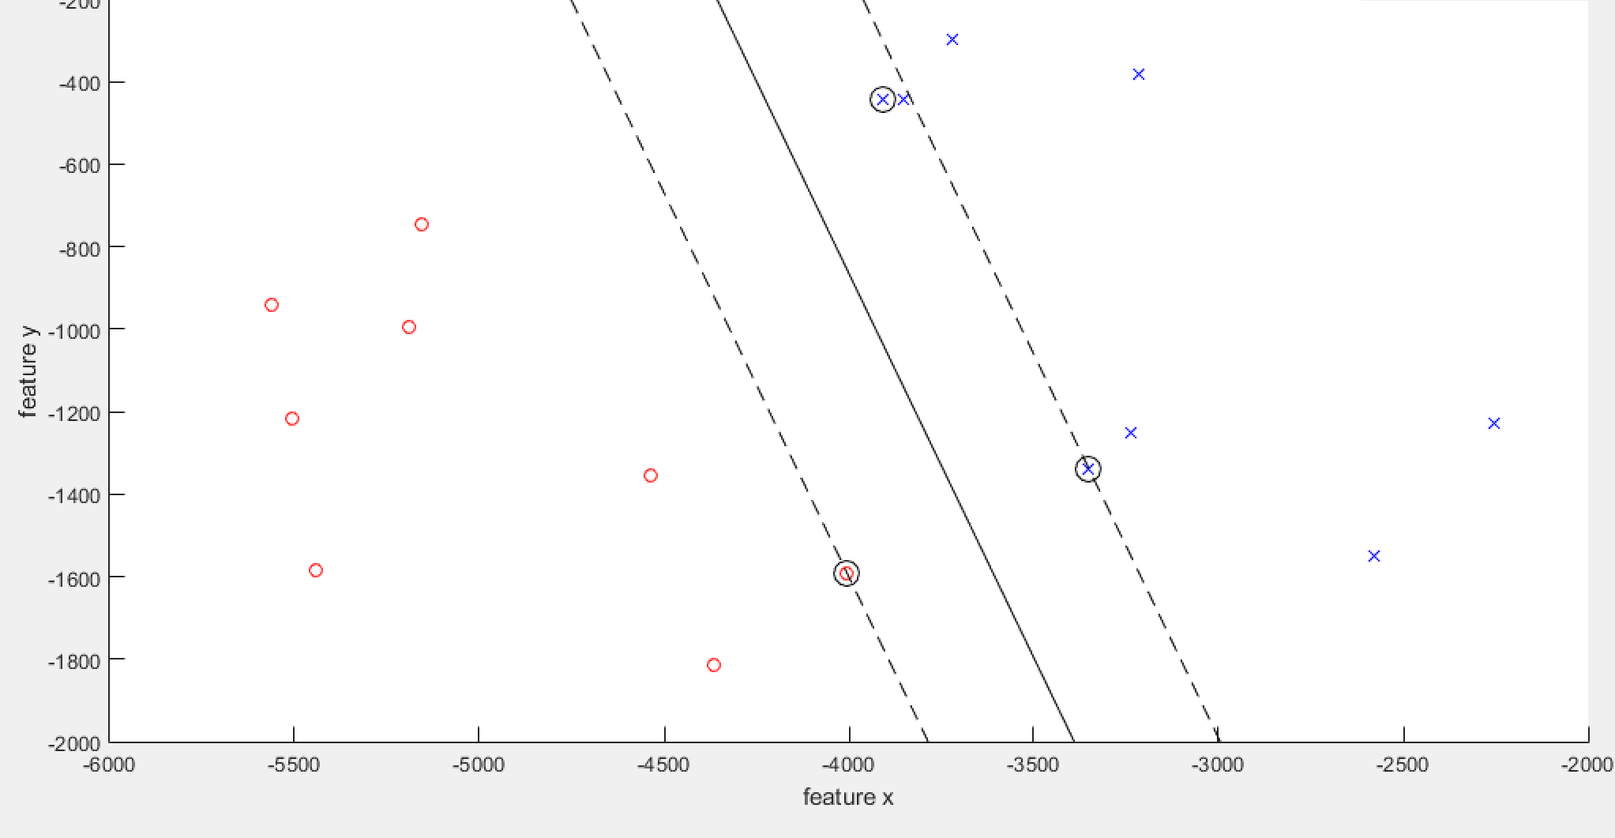
Application to face recognition
X
o
1 2 3 4 5 6 7 8
4
6
Kernel type: linear
Kernel argument: n/a
C: 100
Number of support vectors: 3
Margin: 348.1073
Training error: 0.00%
5
3
4
3
5
6
8
7
1
1
2
8
2
7
Face images and the decision boundary in 2-dimensional eigensubspace

Slide 25
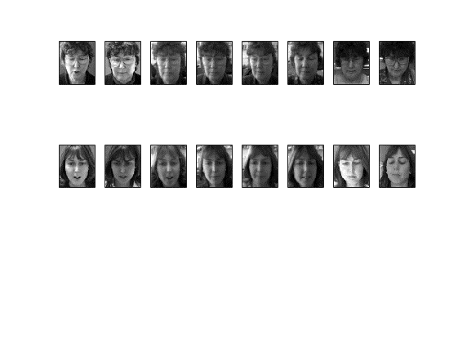
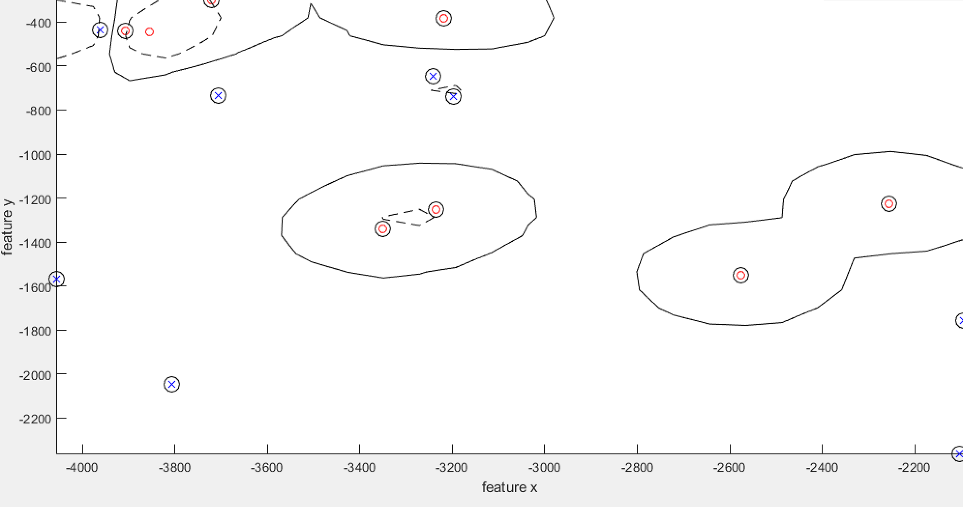
Application to face recognition
X
o
1 2 3 4 5 6 7 8
4
6
5
3
Kernel type: RBF
Kernel argument: 100
C: 100
Number of support vectors: 15
Margin: 0.1980
Training error: 0.00%
5
4
3
6
8
7
1
1
2
8
2
7
Face images and the decision boundary in 2-dimensional eigensubspace

Slide 26
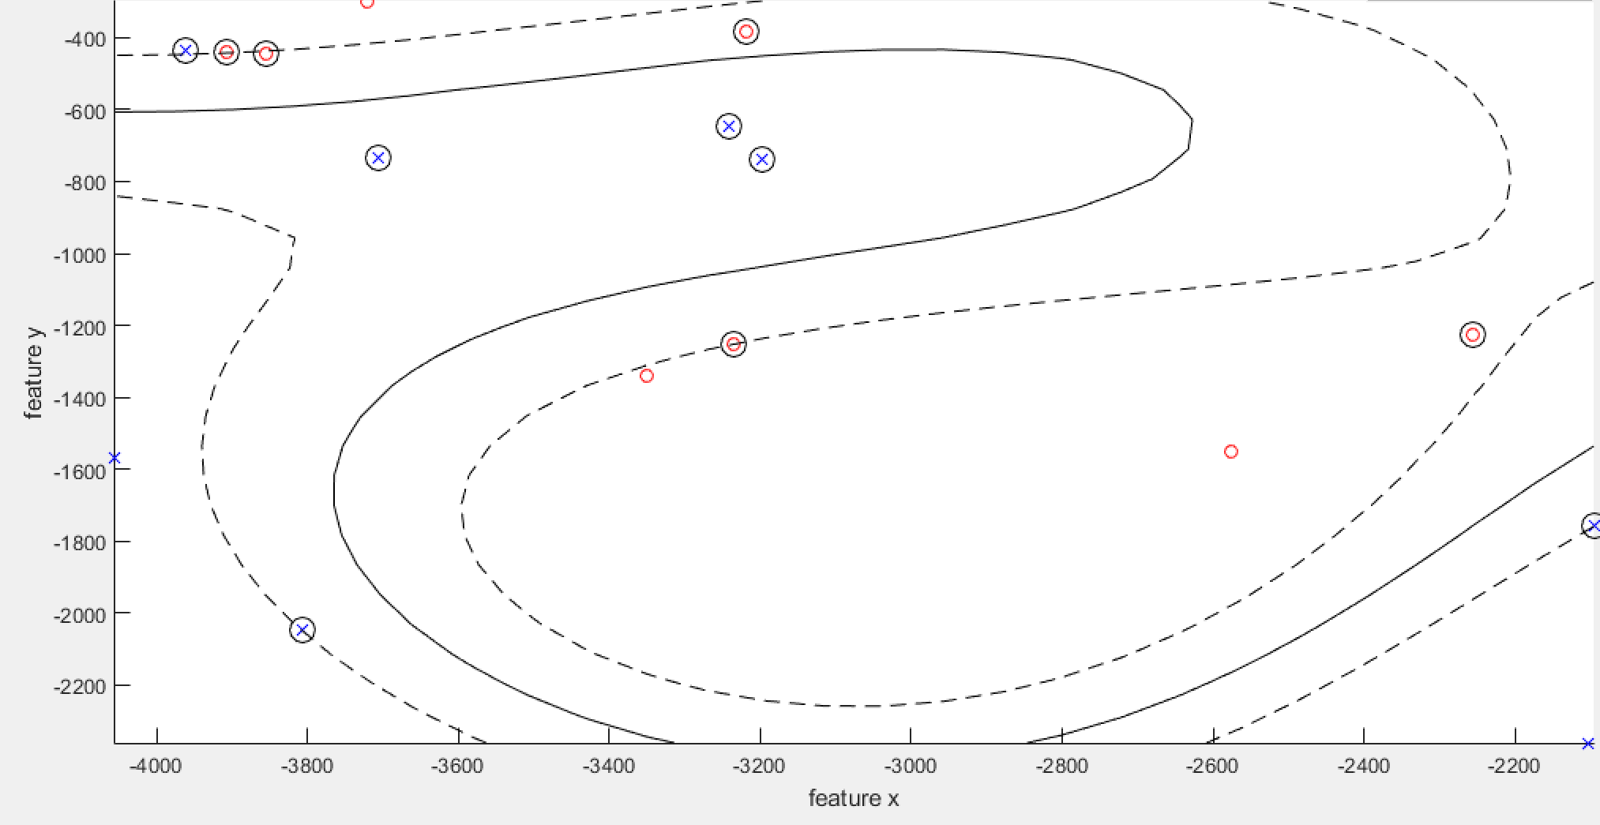
Application to face recognition
X
o
1 2 3 4 5 6 7 8
4
6
5
3
Kernel type: RBF
Kernel argument: 1000
C: 100
Number of support vectors: 11
Margin: 0.0514
Training error: 6.25%
5
4
3
6
8
7
1
1
2
8
2
7
Face images and the decision boundary in 2-dimensional eigensubspace

Slide 27
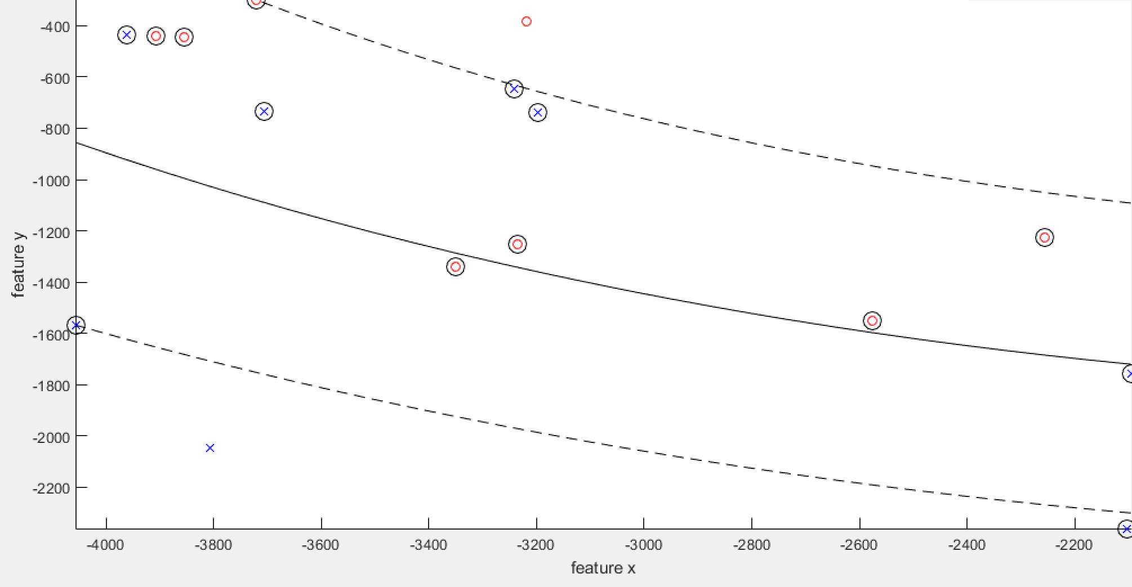
Application to face recognition
X
o
1 2 3 4 5 6 7 8
4
6
Kernel type: RBF
Kernel argument: 5000
C: 100
Number of support vectors: 14
Margin: 0.1008
Training error: 31.25%
5
3
5
4
3
6
8
7
1
1
2
8
2
7
Face images and the decision boundary in 2-dimensional eigensubspace

Slide 28
Multi-class SVM
No definitive multi-class SVM formulation.
In practice, we have to obtain a multi-class SVM by combining multiple two-class SVMs.
One-versus-the-rest
Training:
Given an M-class problem, we train M separate SVMs. Each distinguishes images of one category from images of all the other M-1 categories.
The m-th SVM y_{m}(x) is trained by C_{m} as the positive class and the remaining M-1 classes as the negative class.
Testing (max fusion) :
Given a query image x, we apply each SVM to the query and assign to it the class of the SVM that returns the highest SVM output value
Issues:
The output values y_{m}(x) for different classifiers have no appropriate scales.
The training data sets are imbalanced.
x

Slide 29
Multi-class SVM
One-versus-one
Training:
Given an M-class problem, we train M(M-1)/2 separate SVMs.
We take all possible pairs of classes.
An SVM is learnt for each pair of classes, i.e. C_{i} as the positive class and C_{j} ,j≠i as the negative class.
Testing (majority voting fusion):
Each learned SVM votes for a class to assign to a query image.
Classification of the query image is by assigning the class has the highest number of 'votes'.
Issues:
It requires a large number of SVMs. Training and testing time depends on the complexity of individual SVMs.
A fuzzy case happens if multiple classes receive an equal number of votes.
votes
x
2
1
2
Class 1
1
Class 2
0
3
Class 3

Slide 30
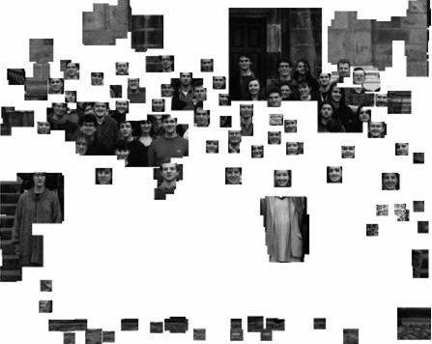
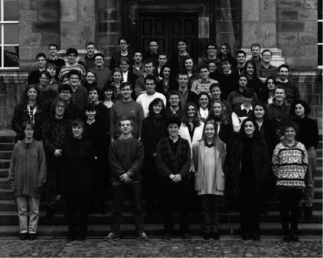
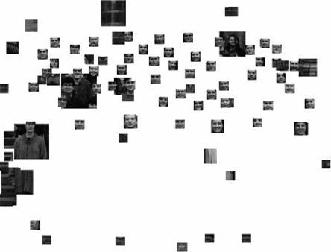
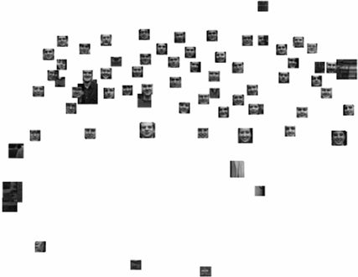
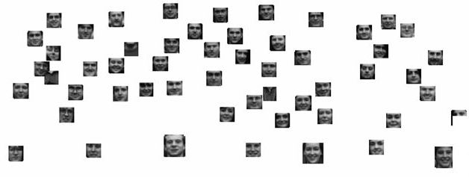
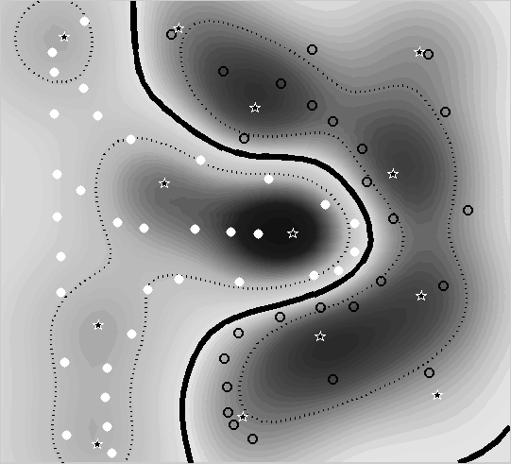
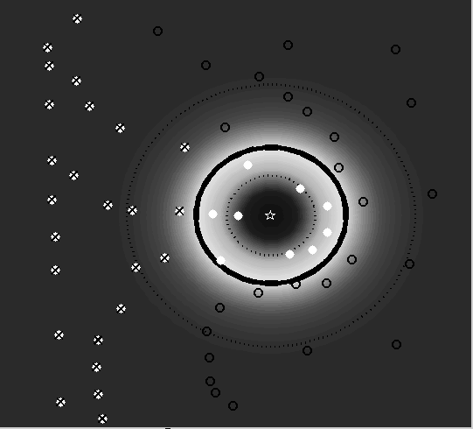
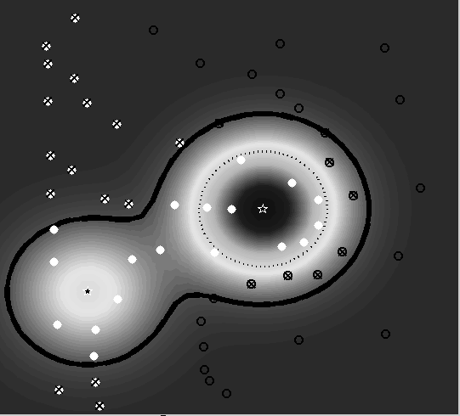
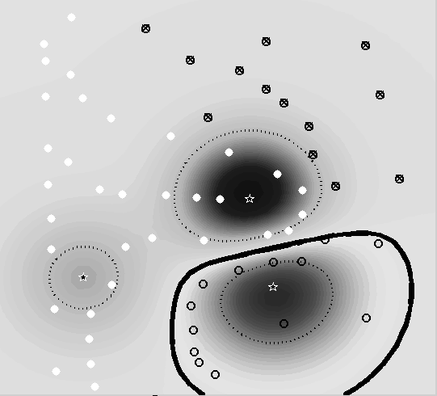
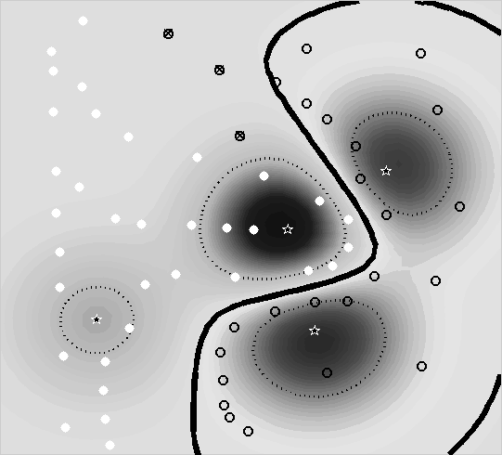
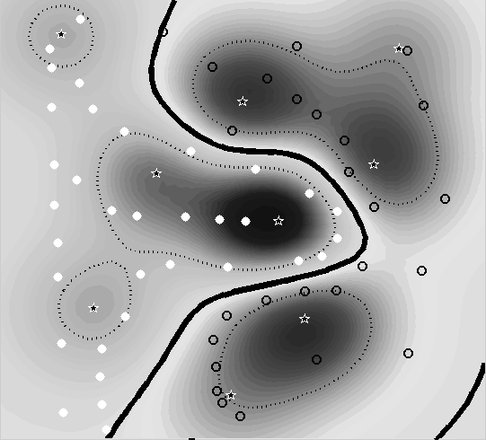
Application to face detection by a cascade of classifiers
Scanning window method: we scan every scale and every pixel location in the image.
It applies a cascade of SVM classifiers, from the simpler to the more complex, to speed up.

Slide 31
SVM pros and cons
Pros
Many publicly available SVM packages: http://www.kernel-machines.org/software
Kernel-based framework is very powerful, flexible
SVMs work very well in practice, even with small training sample sizes
Cons
No direct multi-class SVM, must combine two-class SVMs
Computation and memory in training
During training time, must compute matrix of kernel values for every pair of examples
Learning can take a very long time for large-scale problems
Computational cost of nonlinear SVM classification is very high: O(KxN_{sv} )

Slide 32
Algorithm-independent learning
Unsupervised learning
Supervised learning
Ensemble learning
Generative model
Discriminative model
Randomisation
PCA
FLD/LDA
Committee machine
Maximum margin classifier
Online learning
Regression
Probabilistic model
Feature extraction
Classification
PCA
NN classification
FLD/LDA
Discriminant functions
Maximum margin classifier

Slide 33
Subspace learning
Optimisation
Randomisation
PCA
Projection/pooling
Gradient-based
FLD/LDA
Orthonormal basis vectors
Lagrange multipliers
Dimension reduction
Eigenvalue problem
Data visualisation
Generalized eigenvalue problem
Reconstruction
Gaussian distributions
Underfitting
Generalization
Overfitting
Linear model
Nonlinear model
Training loss
Eigenface
Kernel trick
Testing (real) loss
Fisherface
Feature space
Bayes decision theory

